Slide 1


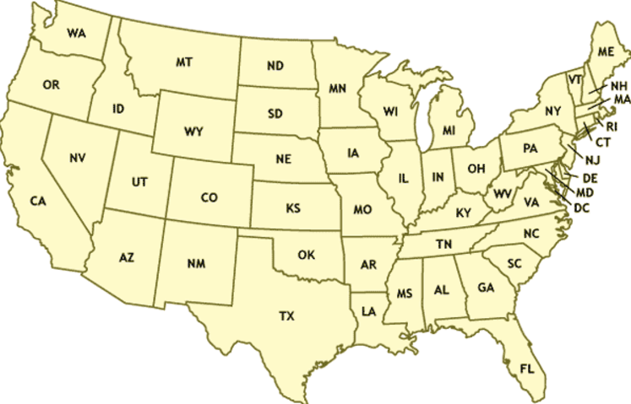
BRANDON
TORRES ASME
BRANDON
TORRES
CSC
American Society of Mechanical Engineering
American Institute with aeronautics and Astronautics
3D Printing Club
state/school/club

Slide 2



BRANDON
TORRES ASME
BRANDON
TORRES
CSC
American Society of Mechanical Engineering
American Institute with aeronautics and Astronautics
3D Printing Club
state/school/club

Slide 3
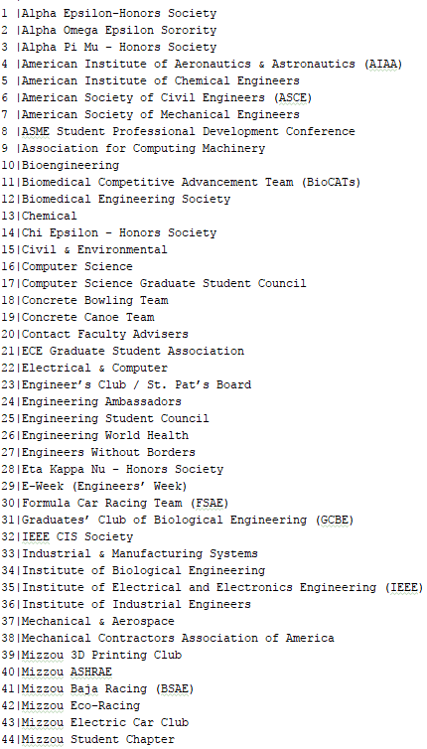
BRANDON
TORRES ASME
BRANDON
TORRES
CSC
American Society of Mechanical Engineering
American Institute with aeronautics and Astronautics
3D Printing Club
CLUBS (LINKS)

Slide 4
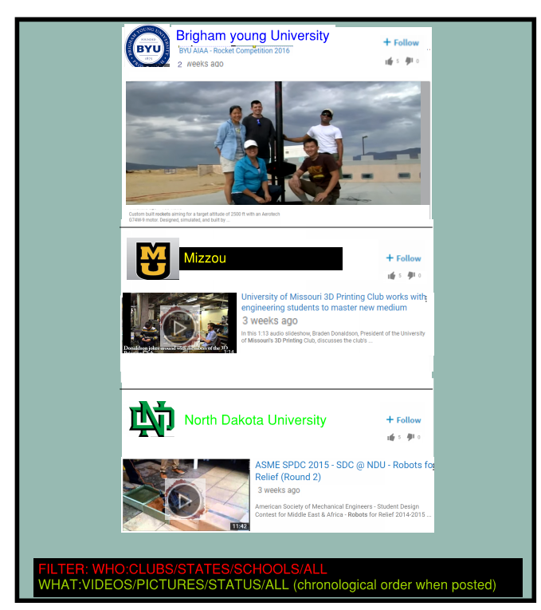
BRANDON
TORRES ASME
BRANDON
TORRES
CSC
American Society of Mechanical Engineering
American Institute with aeronautics and Astronautics
3D Printing Club
Follow

Slide 5

BRANDON
TORRES ASME
BRANDON
TORRES
CSC
American Society of Mechanical Engineering
American Institute with aeronautics and Astronautics
3D Printing Club
Quick Jobs
COMPANY/PERSON | TITLE | Location | DATE START | DATE DUE | REWARD | FILE
Boeing | Design Engineer | Saint Louis MO | 05/22/2017 | 07/05/2017 | $2000
Mike Jones | App Designer | Bridgeton MO | 05/13/2017 | 05/22/2017 | $600

Slide 6
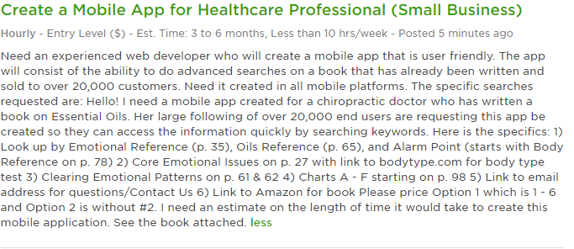
BRANDON
TORRES ASME
BRANDON
TORRES
CSC
American Society of Mechanical Engineering
American Institute with aeronautics and Astronautics
3D Printing Club
Attachment option and blank sheet to write if necessary: LOOKS LIKE THIS
SOME PEOPLE WON’T WANT TO POST THEIR IDEA DIRECTLY WITHOUT SIGNED DOCUMENTATION. IF THAT’S THE CASE
IT CAN BE GENERIC. AND ONLY SAY CONTACT IF INTERESTED. Would like to charge a small fee (10$ or so to post something like this
Or we can think of a better way to make it legit so no scams happen.
CONTACT: TORRESFTW06@GMAIL.COM
NAME: BRANDON
JOB: Need a developer in math.

Slide 7
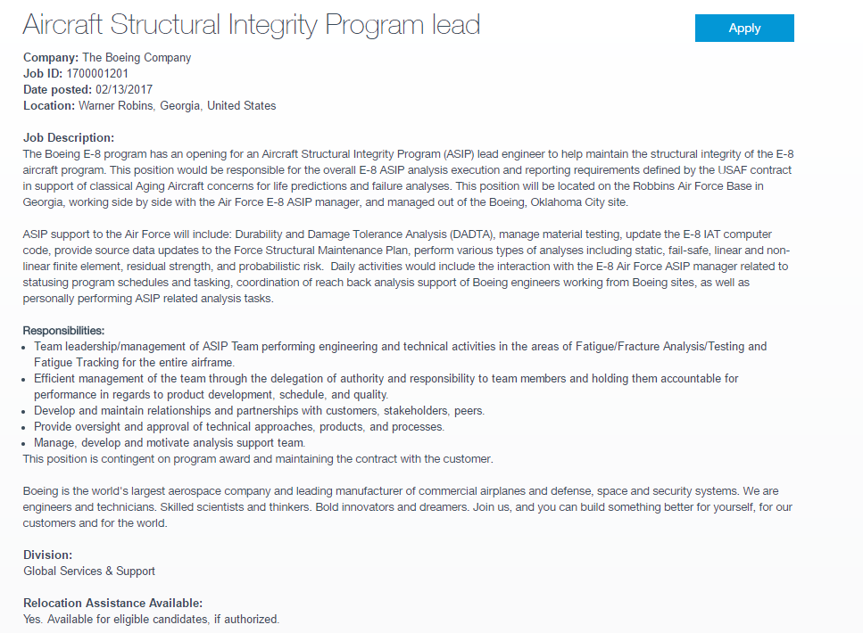
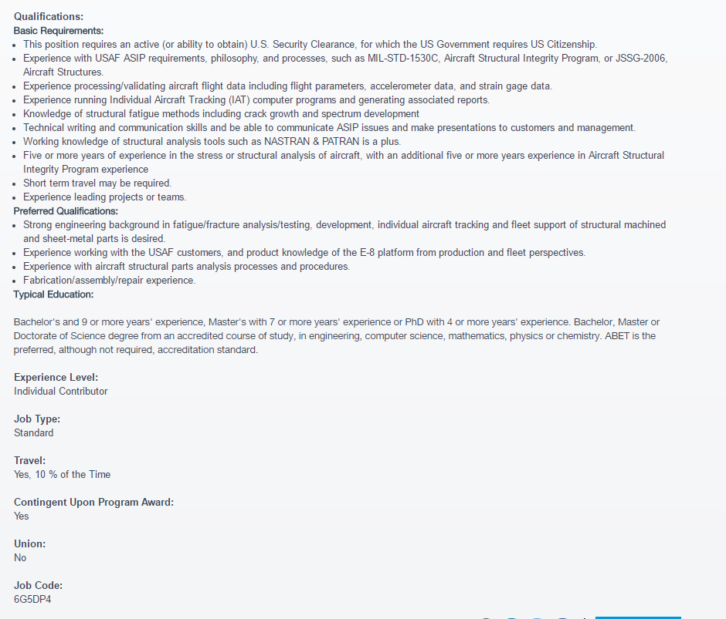
BRANDON
TORRES ASME
BRANDON
TORRES
CSC
Job Opportunities
American Society of Mechanical Engineering
American Institute with aeronautics and Astronautics
3D Printing Club
COMPANY | TITLE | Location | DATE | FILE
Boeing | Design Engineer | Saint Louis MO | 05/22/2017
Universe Corp | Modeler | Bridgeton MO | 05/13/2017
Attachment option and blank sheet to write if necessary: LOOKS LIKE THIS

Slide 8
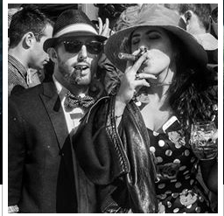
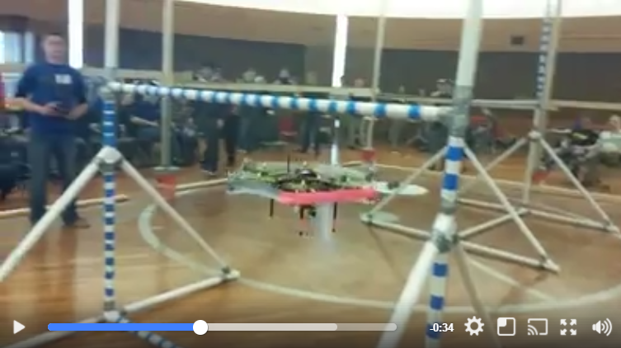

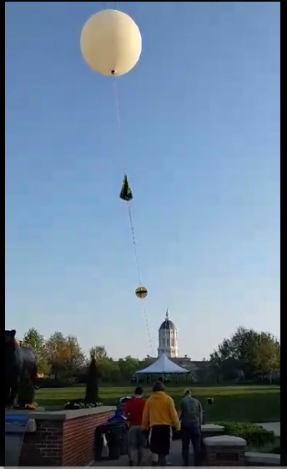
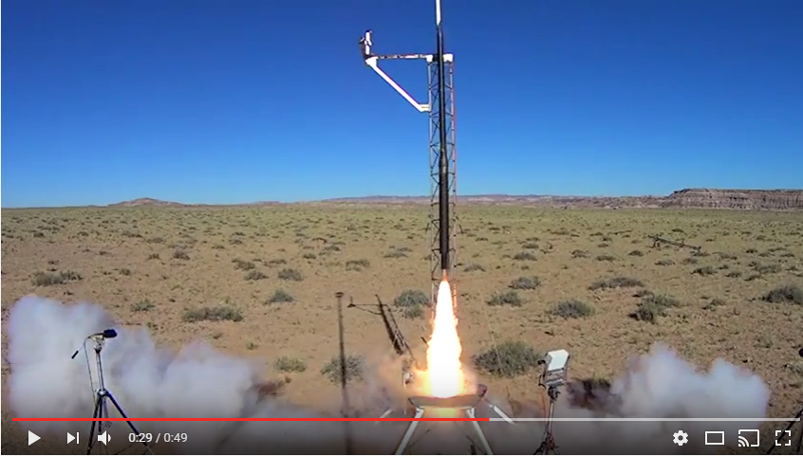
First Page
BRANDON
TORRES ASME
BRANDON
TORRES
BRANDON
TORRES ASME
BRANDON
TORRES
First Name:
Last Name:
Password:
School Email:
Student/Company/Competition Host
Join Now
------------------------------------------------------
If Student is selected. These are added
College:(picking option)
Major: (picking option)
College:___________ (IF NOT EXIST) Ask Name, address
Clubs:
Anticipated Graduation Date: Month/Year
-------------------------------------------------------
If Company is selected. These are added
Company Name:
Company Address:
---------------------------------------------------------
If Competition host is selected, these are added
Majors that compete:
Expected graduation date: Name: Major:
Expected graduation date: BRANDON TORRES MECHANICAL ENGINEERING
May 2017
Add Profile photo
Photos
Videos
MESSAGE
Email
Add Photos
Add Videos
Edit Email Address
Clubs: (CLICK FOR THE CLUB MIZZOU SITE)
American Society of Mechanical Engineers – Vice President
Students for the Exploration and Development of Space- Vice President
American Institute of Aeronautics and Astronautics-Treasurer
3D printing Club-Secretary
Clubs: (Pick by searching @(club_school)
Club Name from above:_________________
Describe your involvement of the club. Talk about your best moment or something interesting to catch attention to the readers. This will only display the first 5 sentences until the reader clicks expand. Add photos/videos to the right showing this moment. The first picture/video will be on display
[ASME] American Society of Mechanical Engineers –
I held the position of team lead when we placed 2nd in the Lighter than Air ASME Robotics competition of 2014. Modeled and 3d printed the frame. Solely designed the landing structure. Soldered electronics and assisted in the coding of the software.
[Displays only 5 sentences, clicks to open]
ADD PHOTOS AND VIDEOS
See more
Add Club
[SEDS]- Students for the Exploration and Development of Space-
Co-created Mizzou chapter of SEDS. Designed rocket to fly to the stratosphere and capture video footage of the curvature of the earth.
About me: (10 sentences)
Write a short summary about yourself. Anything you want someone to read.
See more
[AIAA] American Institute of Aeronautics and Astronautics-
As treasure I managed all funding that came through AIAA. I was also the design leader of the Rocket Team. Designed recovery system of our rocket that went mach 1.4 and 9425ft in the air. Placed 4th in the ESRA Intercollegiate Rocket Engineering Competition.
See more
About me: (10 sentences)
Balsdjfalsdfafj
Asdjf;alsdjfasl;jdfa
Al;sdjfa;lsjdfal;jsdfa
A;lsjdf;lajsdfal;js
As;fjasl;jfal;jsd
Asldjfal;sjdfals;jfa
Al;jsdfa;ljsdfa;ljas
Df;a
[Click for Resume] – (Companies get full access. Students don’t. Students must ask permission with permission notification)
[Click for Resume] – (Companies get full access. Students don’t. Students must ask permission with permission notification)

Slide 9
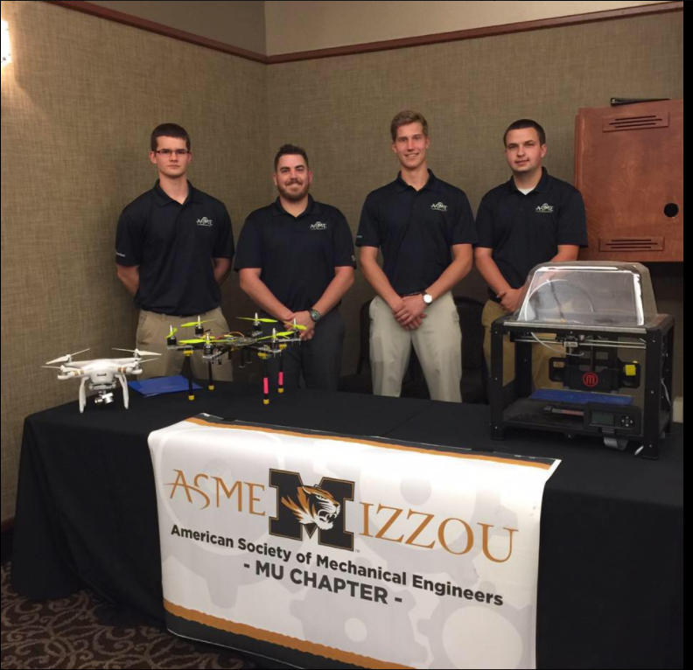
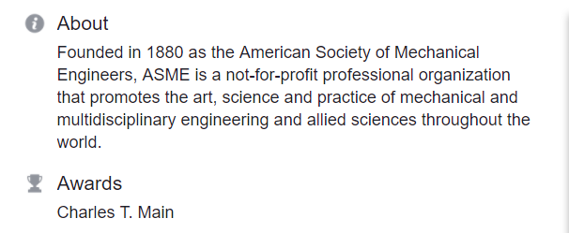
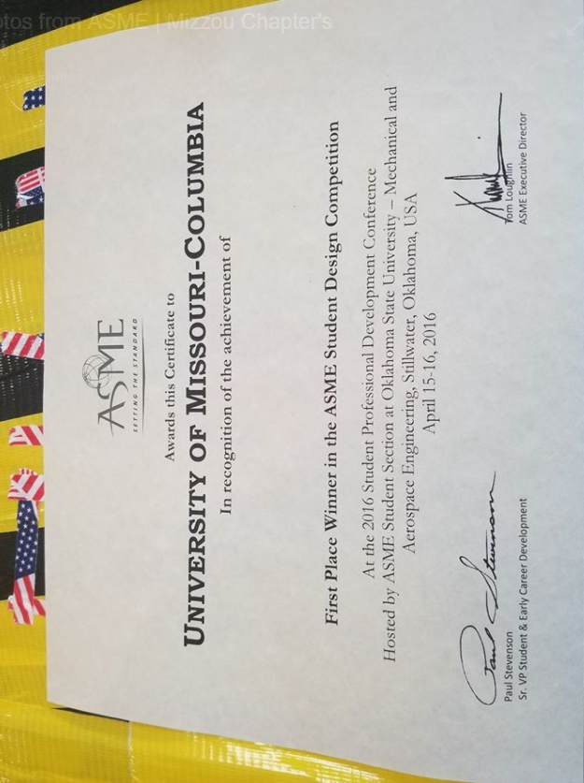
BRANDON
TORRES ASME
BRANDON
TORRES
ASME: American Society of Mechanical Engineers
UNIVERSITY OF MISSOURI COLUMBIA
MEETINGS:
BUILD TEAM MEETINGS: MWF 6:00pm
NEXT MONTHLY MEETING:June 2 2017 time = 6:00pm
Members:
President: Bob Johnson
Vice President- Sarah Sue
CSC Involved: Joe Muenk
more...
COMPETITIONS:
ASME ROBOTICS 2017
ASME ROBOTICS 2016
ESRA 3D MECHANICS 2015
MAJOR:
90% MECHANICAL
5% ELECTRICAL
3% COMPUTER SCIENCE
2% BUSINESS
[ASME] American Society of Mechanical Engineers –
DATE: 01-25-2017
We have a robotics team that travels around the world and competes against all different universities. The team is lead by Brandon Torres, a senior mechanical Engineer as well as advisor Dr. Solbreken. Together we learn to overcome real world challenges in a smaller scale through competition. If you are into robotics, challenges, and competition please follow us on CSC and come to our meetings!!!

Slide 10
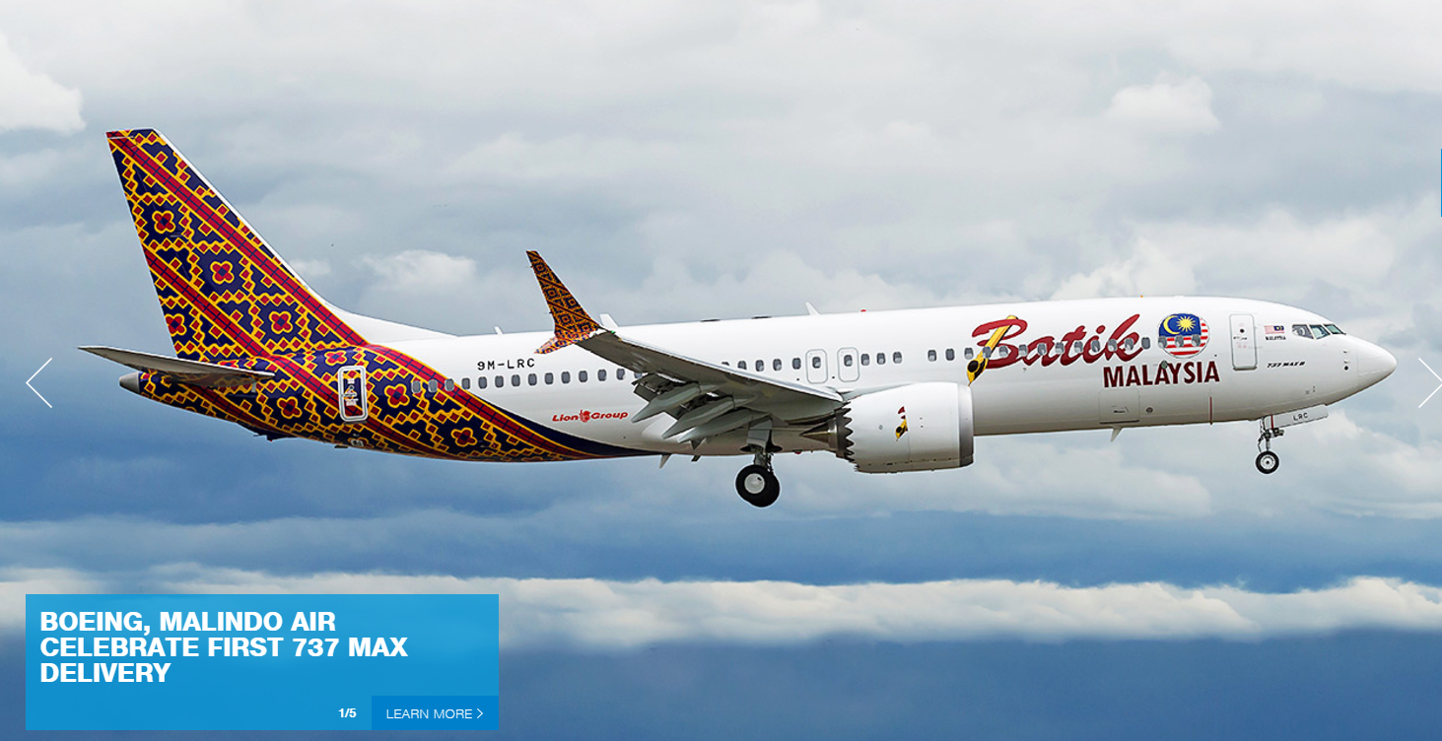

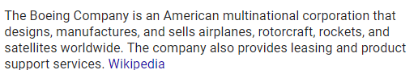
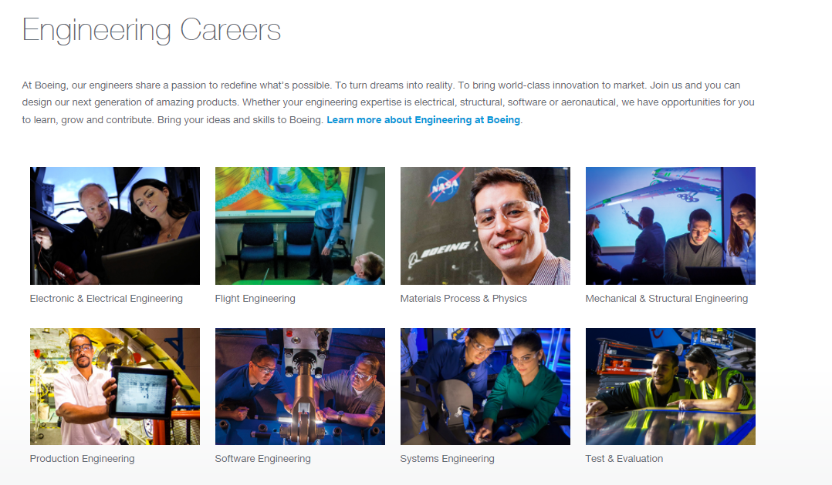
BRANDON
TORRES ASME
BRANDON
TORRES
Validated
BOEING
ABOUT:
What we look for:

Slide 11

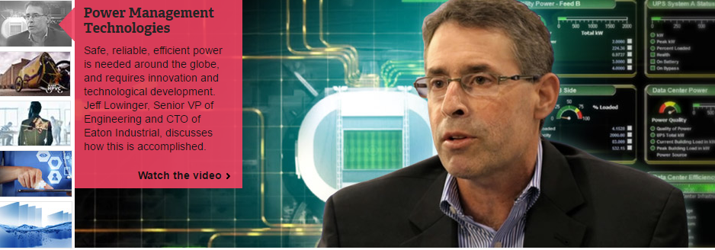




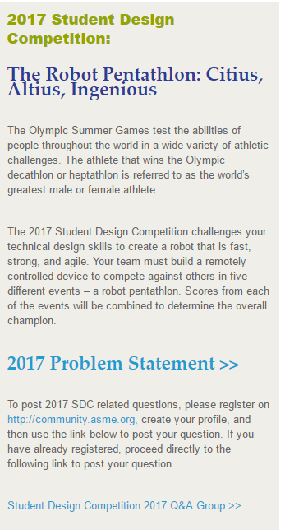
BRANDON
TORRES ASME
BRANDON
TORRES
Validated
ASME: American Society of Mechanical Engineers
Wanna be a ASME National member?
ABOUT:
COMPETITIONS:
IDSC THE CHALLENGE:
DATE: MAY 1 2018
WHO: ASME MEMBERS
WHERE: TBD
THE ROBOT PENTATHLON
DATE: JUNE 11 2018
WHO: ASME MEMBERS
WHERE: TBD

Slide 12
First Page
First Name:
Last Name:
Password:
School Email:
Student/Company/Competition Host
Join Now
------------------------------------------------------
If Student is selected. These are added
College:
Major:
College:___________ (IF NOT EXIST) Ask Name, address
Clubs:
Anticipated Graduation Date: Month/Year
-------------------------------------------------------
If Company is selected. These are added
Company Name:
Company Address:
---------------------------------------------------------
If Competition host is selected, these are added
Majors that compete:

